Slide 1
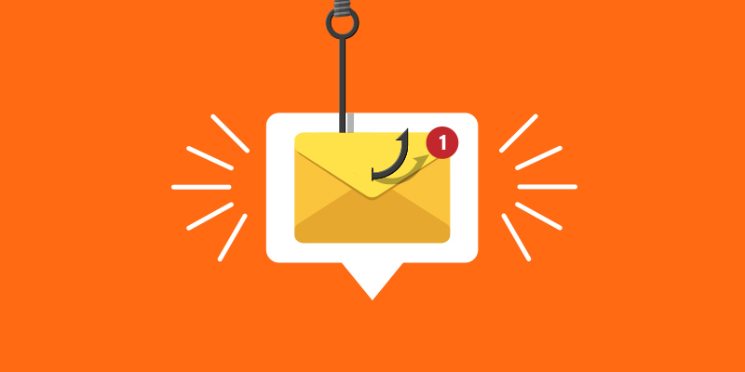
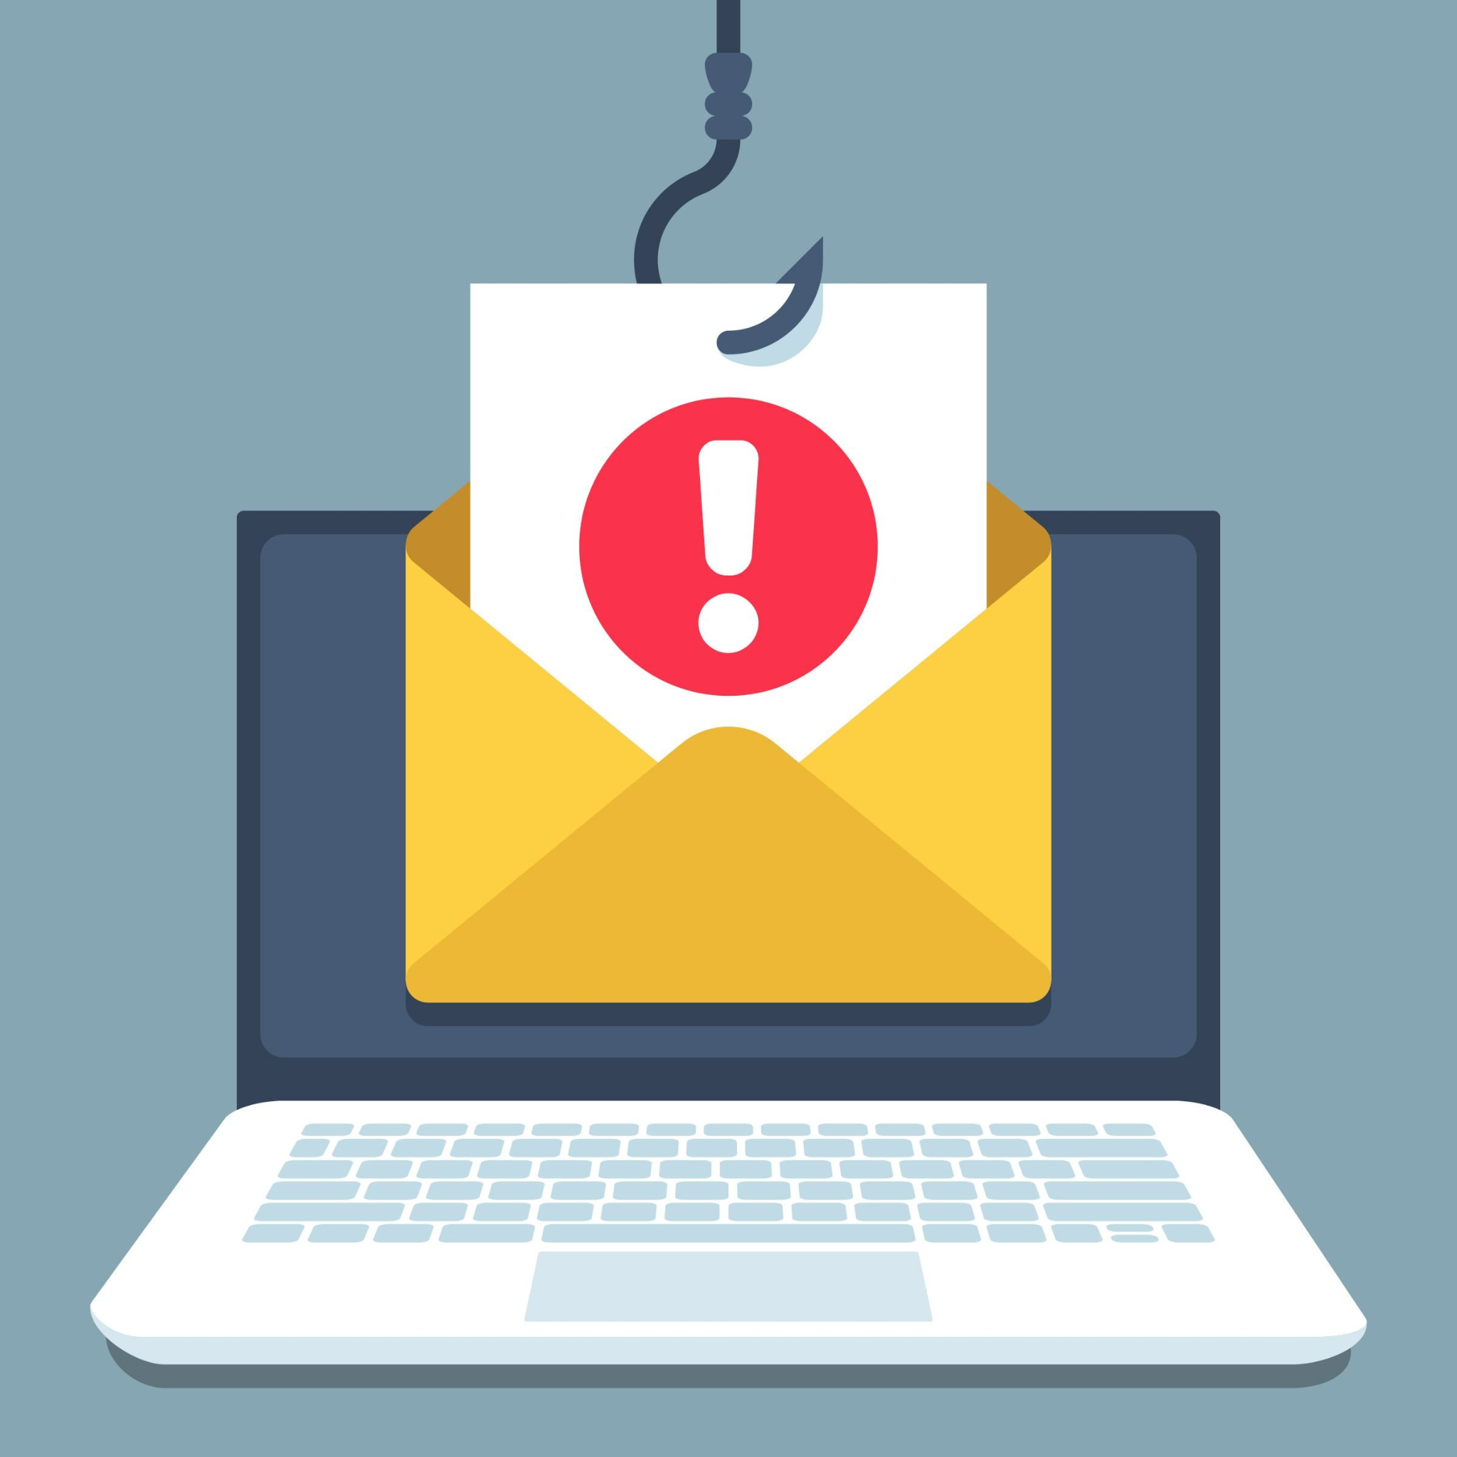
How to Detect
Phishing and Keep
your Device Secure

Slide 2
What is Phishing
Phishing is the fraudulent practice of sending emails or other messages purporting to be from reputable companies in order to induce individuals to reveal personal information. Information could include:
Passwords
Credit Card Numbers
Social Security Numbers

Slide 3
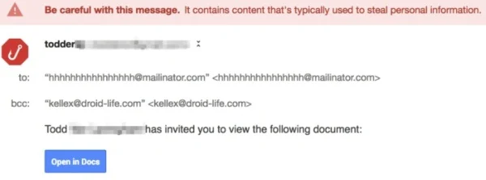
Phishing Examples
Fake invoice
Email account upgrade
Advance-fee
Google Docs Scam
Paypal Scam
Message from HR scam
Dropbox scam the council tax scam

Slide 4
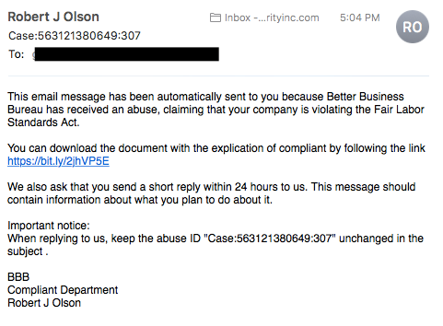
Types of Phishing attacks
Spear Phishing- Targets a specific group or type of individual

Slide 5
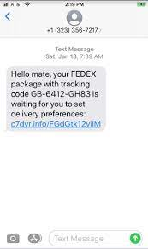
Types of Phishing attacks
Whaling- Typically targets heads of companies
Vishing- After personal information but done over the phone
SMS Phishing- Sent by unknown numbers in hopes of tricking you

Slide 6
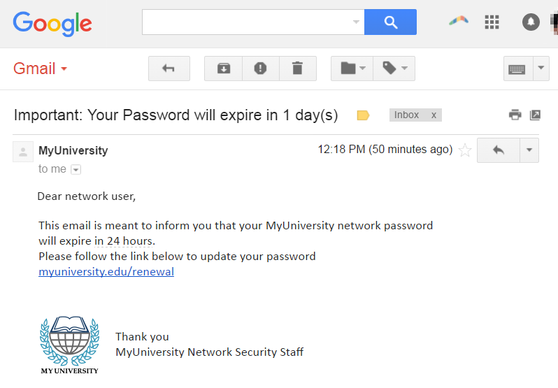
Types of Phishing Attacks
Email Phishing - Most common, Most successful, often looks real, normally informs you that there has been a compromise to your account.
Pharming- This is a cyberattack intended to redirect website’s traffic to another so malware can secretly be installed.

Slide 7
Red Flags of Phishing Emails
Unfamiliar tone or greeting
Grammar and spelling errors
Inconsistencies in Email Addresses, Links & Domain Names
Threats or sense of urgency
Suspicious Attachments

Slide 8
Red Flags of Phishing Emails
Unusual Request
Short and Sweet
Recipient Did Not Initiate the Conversation
Request for Credentials, Payment Information or Other Personal Details

Slide 9
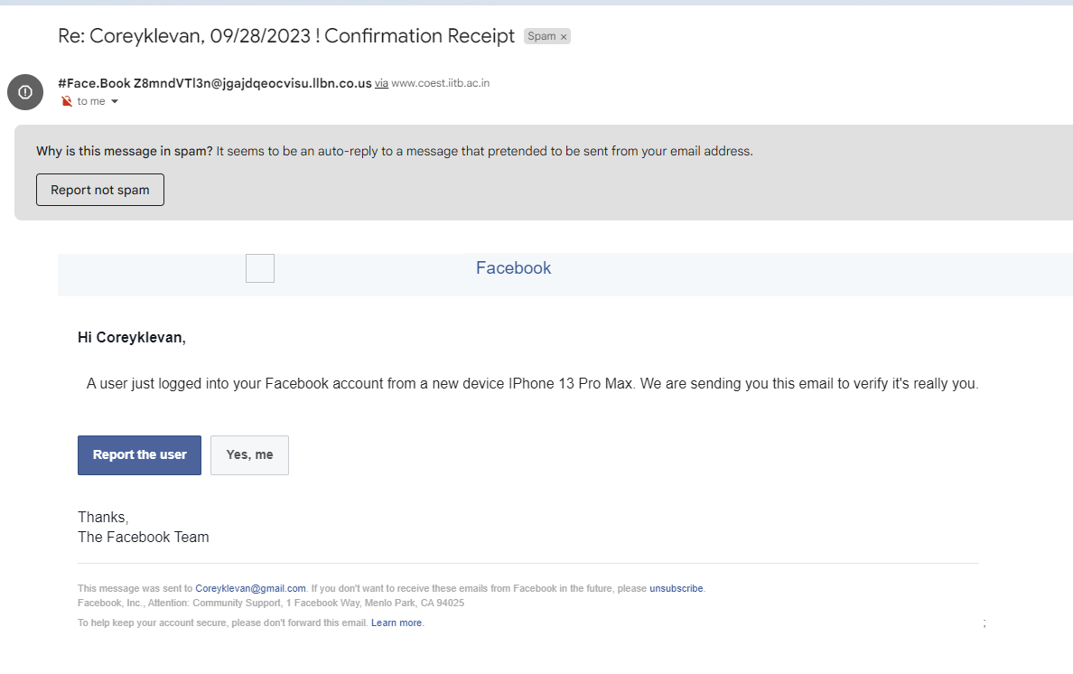
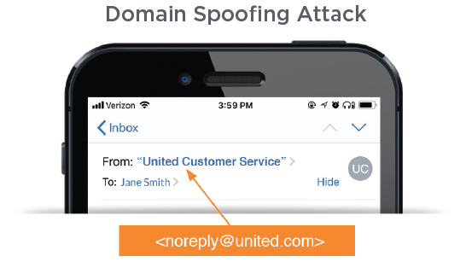
Email Spoofing and its Dangers
Email spoofing is a technique used in spam and phishing attacks to trick users into thinking a message came from a person or entity they know or trust. In spoofing attacks, the sender forges email headers so that client software displays the fraudulent sender address, which most users take at face value.

Slide 10
Email Spoofing and its Dangers
Malware insertion
Identity Theft
Access to personal/business assets
Spam Filter avoidance
Reputational Damage
Financial Losses
Accounts hacked

Slide 11
Dangers of Phishing
Cause financial loss for victims
Put their personal information at risk
Put university data and systems at risk
And the same as Spoofing Dangers

Slide 12
General Practices
Never click on any links in an email you are unsure of
If you don’t know don’t respond and report
Never download anything from a suspicious website/email
IT can help identify phishing emails
Adblockers- Block online advertisements that can secretly install malware
Email Encrypters
Check links and files here

Slide 13
General Practices
When sending personal Information use an email encryptors (see previous slides link)
Be cautious when opening links and unknown documents

Slide 14
Web Safety
Keep Software and hardware up to date
Regularly check for updates on all the apps you use and in the settings of the device you are using. Out of date software and hardware can be vulnerable to attacks to your device.
Change default settings for the device
Using default settings on a device can make for quick and easy set up but it can also lead to vulnerabilities in your system that can lead you to get hacked.
Use VPN (Virtual Private Network)
Should be used when connecting to public hotspots in order to protect private data from potential threat actors.

Slide 15
Web Safety Continued
Use Strong passwords and password managers to store your passwords
If using a password manager, create one unique strong Master Password
Back up your Data regularly
Backing up your data is very important. You should do this at least once or twice a month. If you feel as though your computer or device has been hacked you can use the backed up data as a restore point.
Avoid Jailbreaking/rooting your Device
Jailbreaking and Rooting weakens your device's built-in security features. Fraudsters prey upon weakly secured mobile devices. They monitor device memory and app usage to gather personal information and distribute malicious apps that introduce your device to malware designed to compromise your personal data.

Slide 16
Extra Resources
Ryan Kelly- He’s a comedian but has a lot of content on his social medias about Phishing and Email scams: https://linktr.ee/YouthPastorRyan
Check to see if your email has been a data breach https://haveibeenpwned.com/
Check to see if your password has been cracked https://haveibeenpwned.com/Passwords
Check to see how strong your password is https://www.passwordmonster.com/

